Slide 1
M11L7 – Three-Dimensional Figures
01-05-2023
Federal Entity | هيئة اتحادية

Slide 2
Learning Objectives
• Describe three-dimensional figures and
determine the shapes resulting from
horizontal, vertical, and angled cross
sections.

Slide 3
Describe 3D Figures
(Page 745)

Slide 4
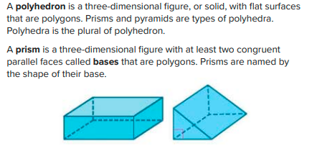
Main Headline
Body Copy

Slide 5
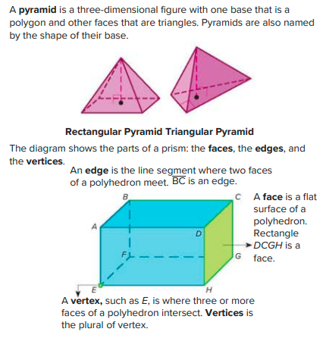

Slide 7
Example 1
(Page 746)

Slide 8
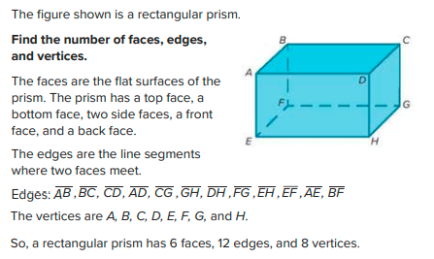
Main Headline
Body Copy

Slide 9
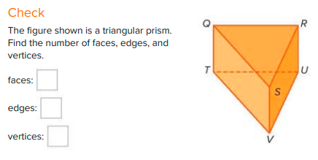

Slide 10
Describe Cross Sections of 3D Figures
(Page 747)

Slide 11
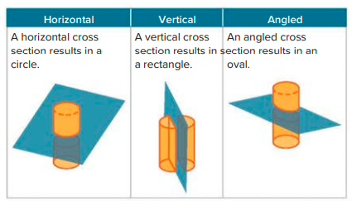
Main Headline
Body Copy

Slide 13
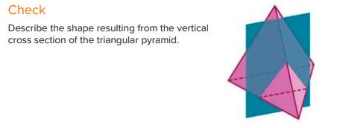

Slide 14
Example 3
(Page 748)

Slide 15
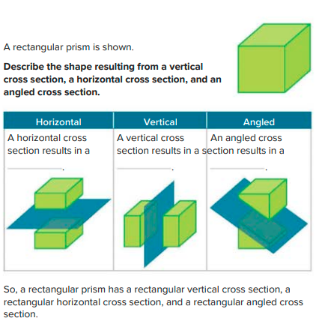
Main Headline
Body Copy

Slide 16
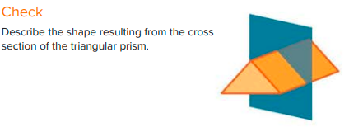

Slide 17
Practice
(Page 749)

Slide 18
Main Headline
Body Copy

Slide 19
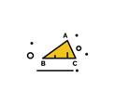

Slide 20
Follow us
ese.ae
Ese_ae

