Slide 1
M11L6 – Scale Drawings
28-04-2023
Federal Entity | هيئة اتحادية

Slide 2
Learning Objective
• Use ratio reasoning to find actual lengths
and areas from a scale drawing and
reproduce a scale drawing at a different
scale.

Slide 3
Use Scale Drawings to Find Lengths
(Page 733)

Slide 4
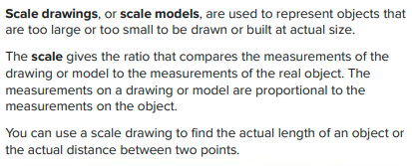
Main Headline
Body Copy

Slide 5
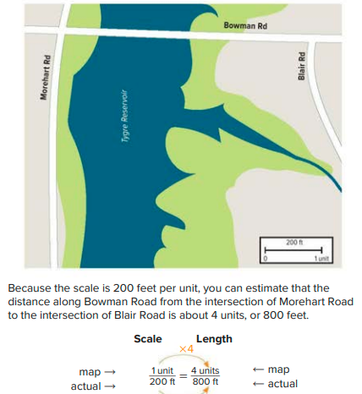

Slide 6
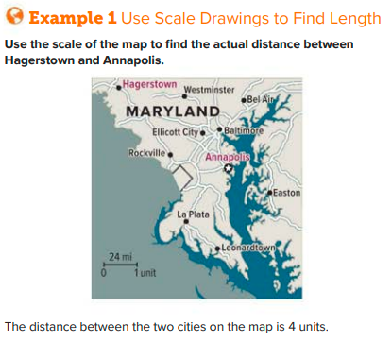

Slide 8
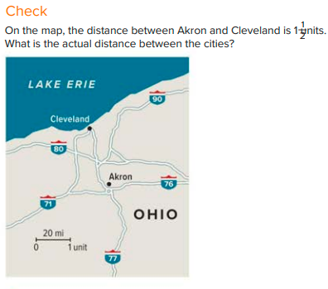

Slide 9
Use Scale Drawings to Find Area
(Page 736)

Slide 10
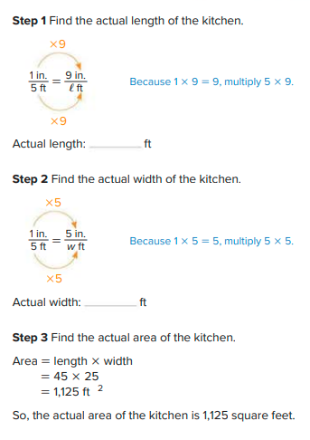
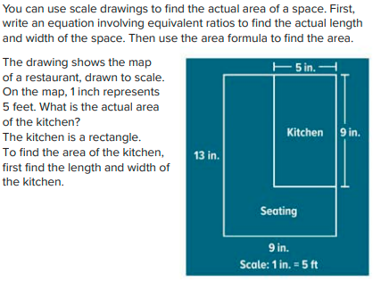
Main Headline
Body Copy

Slide 11
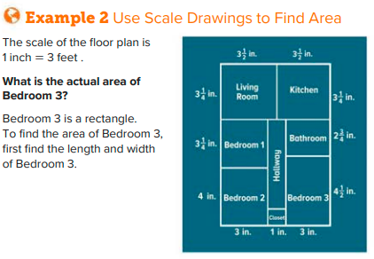
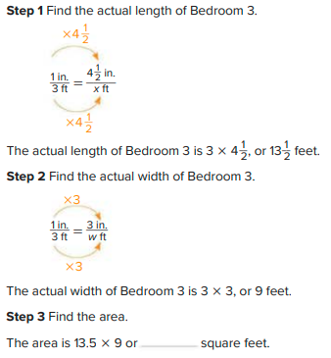

Slide 12
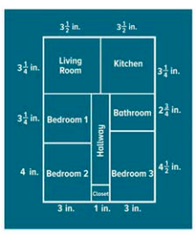

Slide 13
Reproduce Scale Drawings
(Page 738)

Slide 14
Main Headline
Body Copy

Slide 17
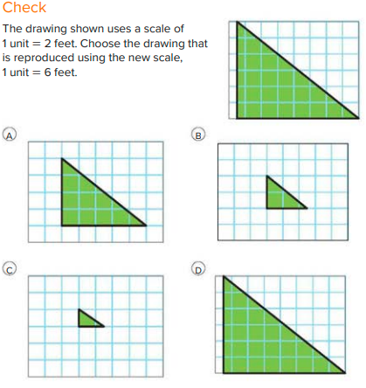

Slide 18
Check
(Page 741)

Slide 19
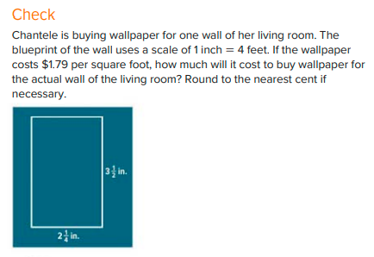
Main Headline
Body Copy

Slide 20
Find Scale Factor
(Page 742)

Slide 21
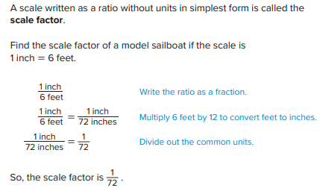
NOTE:
1 feet = 12 inches
Body Copy

Slide 22
Practice
(Page 744)

Slide 23
Main Headline
Body Copy

Slide 24
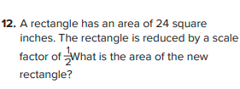

Slide 26
Follow us
ese.ae
Ese_ae

