Slide 1
U1M1L1 Position and Motion

Slide 2
Where are you right now?
How would you describe where you are right now?
You might say that you are sitting one meter to the left of your friend. You might explain that you are at home, which is two houses north of your school.
Describing Position
What do these descriptions have in common? Each states your location relative to a certain point. This point is called the reference point.
A reference point is the starting point you choose to describe the location, or position, of an object.
The reference point in the first example is your friend. In the second example, it is your school. Each description of your location also includes your distance and direction from the reference point
A position is an object’s distance in a certain direction from a reference point.
A complete description of your position includes a distance, a direction, and a reference point.

Slide 3
The Reference Direction
Sometimes direction is described using the words positive or negative.
The reference direction is the positive (+) direction.
The opposite direction is the negative (-) direction.

Slide 4
Suppose east is the reference direction in the diagram below. The museum’s entrance is 80 m east of a bus stop. The library is 40 m west of the bus stop. You could say that the museum is +80 m from the bus stop and the library is -40 m from the bus stop. Using the words positive or negative to describe direction can help explain changes in an object’s position

Slide 5
Moving in Two Dimensions
Sometimes you need to use more than one reference direction to describe an object’s position. When you describe position using two directions, you are using two dimensions.
Describing Position in Two Dimensions
To describe a position on a map, you might choose north and east or south and west as the reference directions. Sometimes north, south, east, and west are not the most useful reference directions. Imagine that you are looking at a skyscraper. You might describe a certain window as “up” and “to the left.”

Slide 6
position in two dimensions
Suppose you want to locate your classmate’s home on a map.
To find a position in two dimensions,
first choose a reference point. You could choose your home as a reference point.
Next, give specific reference directions. For example, south and east.
Then, determine the distance along each reference direction.
For example, your classmate’s home might be one block south and four blocks east of your home

Slide 8
What is motion?
Sometimes you need to describe how an object’s position changes. Suppose a boat is floating on a lake.
Motion
How do you know whether the boat has moved throughout the day? You know this when its position changes relative to, or compared to, something else. Motion is the process of changing position

Slide 9
Observing Motion
Is the man in the figure below in motion?
Use the fishing pole as the reference point. The positions of the man and the pole do not change relative to each other. The man does not move relative to the pole. When the buoy is the reference point, the man’s distance from the buoy changes. The man is in motion relative to the buoy

Slide 11
Motion Using Reference Points
How would you describe the position of the soccer player in the figure?
If the reference point is the goal, or point A, the player’s position is 10 m in front of the goal. If the reference point is center field, point B, the position is 40 m toward the goal. The actual location of the player does not change. The description of the position changed because the reference point changed

Slide 13
Distance and Displacement
Suppose a baseball player runs the bases.
Distance is the length of the path the player runs.
Suppose he runs 25 m to get to first base. When he gets to second base, he has run 25 m + 25 m = 50 m.
Displacement is the difference between the initial (first) position and the final position of an object.
The initial position is home plate.

Slide 15
Distance and Displacement
At first base, the player’s distance and displacement are the same.
He has run a distance of 25 m and he is 25 m from home plate, where he started. At second base, distance and displacement are different. The player has run a distance of 50 m, but his displacement is 35 m from home plate.
Once the player has runs all the bases and is back at home plate, he has run 100 m (25 m × 4), but his displacement is 0 m.
His starting position and ending position are the same—home plate.
Distance depends on the path taken. Only the starting and ending positions matter in displacement.
Notice that distance and displacement are equal only if the motion is in one direction.

Slide 18
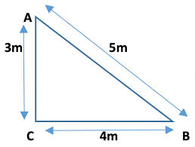

Slide 19
Test your self
https://wordwall.net/resource/23077897/displacement-and-distance

Slide 20
DISTANCE | DISPLACEMENT
The total length of the path the object travelled No need to mention direction (magnitude only ) = value =number | The difference between initial and final positions (the shortest distance between them ) Direction is important Magnitude + direction
Both are measured in meters (m)

Slide 21
What do you measure to determine motion?
How fast do you walk when you are hungry and you smell good food in the kitchen?
Sometimes you move quickly. Other times you might move slowly.
Changes Over Time
One way you can describe how fast you move is to determine your speed.
Speed is the measure of the distance an object travels per unit of time

Slide 23
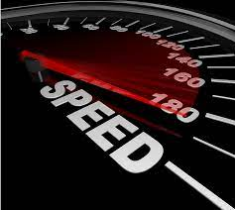
Constant and Changing Speed
Speed is either constant or changing. Look at the figure next slide.
The stopwatches show the girl’s motion every second for 6 seconds.

Slide 24
In the first 4 seconds, she travels the same distance during each second. This means that she was moving with constant, or unchanging, speed. When the girl starts running, the distance she travels each second gets larger and larger. The girl’s speed changes

Slide 27
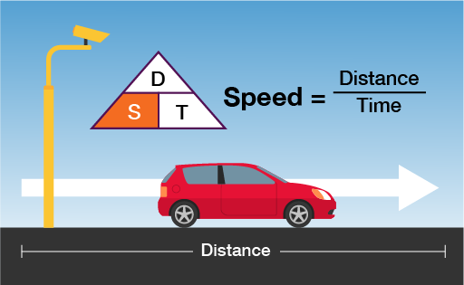
Average Speed
Suppose you want to know how fast you traveled from the park to the library. As you moved, your speed changed from second to second. Therefore, in order to describe your speed, you describe the average speed of the entire trip.
Average speed is a ratio. It is the distance an object moves divided by the time it takes for the object to move that distance.
If you traveled the 1-km distance to the library in 15 min, or 0.25 h, your average speed was 1 km/0.25 h, or 4 km/h.

Slide 28
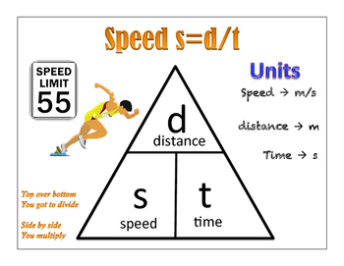

Slide 31
Speed and Direction
Velocity is the speed and direction of an object’s motion.
Velocity is a vector.
A vector is a quantity that has magnitude and direction. Arrows often represent vectors.
The length of the arrow represents the speed of an object. The arrow points in the direction in which the object is moving.

Slide 32
Constant and Changing Velocity
Velocity is constant, or does not change, when an object’s speed and direction of movement do not change.
Look at arrows in the left box in the figure below. Each segment is the same length. This means the cyclists are moving the same distance and in the same direction during each unit of time. Both speed and direction of movement are constant, so the cyclists are moving at a constant velocity

Slide 34
Constant and Changing Velocity
The arrows in the middle box get larger each second. The speed is changing, so the velocity is also changing. Velocity can change even if the speed of an object remains constant. Recall that velocity includes an object’s speed and the direction it is traveling.

Slide 35
How can a graph help you understand an object’s motion?
In the study of motion, the two measurements that are compared are time and distance.
Distance-Time Graphs
Graphs that show comparisons between time and distance are called distance-time graphs.

Slide 36
DRAW THE DISTANCE – TIME GRAPH
TIME (S) | DISTANCE ( m/s)
1 | 10
2 | 20
3 | 30
4 | 40
5 | 50

Slide 37
The change in distance is the same each second on the graph below, which represents an object moving at constant speed. Constant speed is shown as a straight line on distance-time graphs.

Slide 38
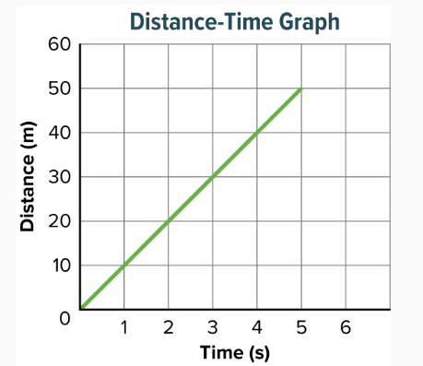

Slide 39
page 23

Slide 41
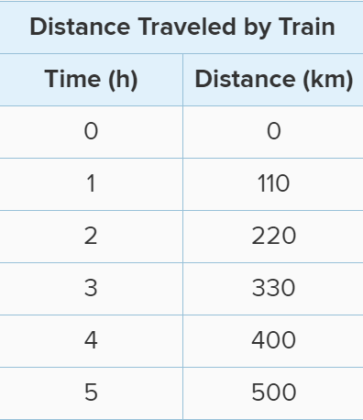
Investigation page 22

Slide 45
Phet
https://phet.colorado.edu/sims/cheerpj/moving-man/latest/moving-man.html?simulation=moving-man

