Slide 1
SUBJECT – MATHEMATICS
GRADE – 7
Chapter 11 – Lesson 2
Complementary and Supplementary Angles

Slide 2
Chapter 11-L2-Complementary and Supplementary Angles
Objective of Session
To understand about complementary angle and supplementary angles

Slide 3
Chapter 11-L2-Complementary and Supplementary Angles
Vocabulary:
Complementary Angle
Supplementary Angle

Slide 4
Chapter 11-L2-Complementary and Supplementary Angles

Slide 5
Chapter 11-L2-Complementary and Supplementary Angles
Point A
Reflection of Point A

Slide 6
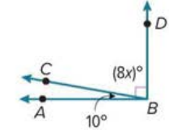
Chapter 11-L2-Complementary and Supplementary Angles

Slide 7
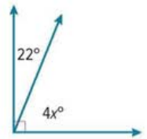
Chapter 11-L2-Complementary and Supplementary Angles
40
40
2
5

Slide 8
Chapter 11-L2-Complementary and Supplementary Angles
Objective of Session
To understand about supplementary angles

Slide 9
Chapter 11-L2-Complementary and Supplementary Angles

Slide 10
Chapter 11-L2-Complementary and Supplementary Angles

Slide 11
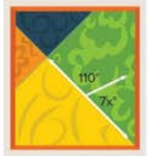
Chapter 11-L2-Complementary and Supplementary Angles

Slide 12
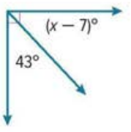
Chapter 11-L2-Complementary and Supplementary Angles
40
40
2
5

Slide 13
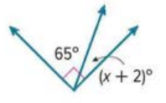
Chapter 11-L2-Complementary and Supplementary Angles
40
40
2
5

Slide 14
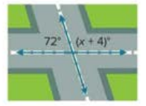
Chapter 11-L2-Complementary and Supplementary Angles

Slide 15
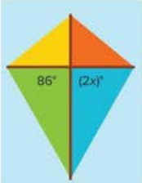
Chapter 11-L2-Complementary and Supplementary Angles

