Slide 1
Grade 7
Elite Mathematics
Academic Year 2022/2023 – Term 3

Slide 2
Unit 8 – Multiply decimals
P 677
Unit 11 – Geometric figures
Lesson no. 1
Lesson name:
Vertical and adjacent angles

Slide 3
Learning objectives
Identify vertical and adjacent angles and use them to write and solve equations to find unknown angle measures.

Slide 4
Keywords
Acute angle.
Adjacent angle.
Congruent.
Obtuse angle.
Right angle.

Slide 5
Task Board 7A
Group leaders' task :
When finishing a question, you only come to me for correction.
Then you go correct to your group.
Make sure they all understand, and their books are corrected.
Taking attendance+ putting stars + Cleaning the board
Collecting notebooks for correction- returning them
Group leaders For today
Red Group 1 leader
Red Group 2 leader
Red Group 3 leader
Green Group 1 leader
Green Group 2 leader
Blue Group 1 leader

Slide 6
Task Board 7B
Group leaders' task :
When finishing a question, you only come to me for correction.
Then you go correct to your group.
Make sure they all understand, and their books are corrected.
Taking attendance+ putting stars + Cleaning the board
Collecting notebooks for correction- returning them
Group leaders For today
Red Group 1 leader
Red Group 2 leader
Green Group 1 leader
Green Group 2 leader

Slide 7
Attendance
Who is here?

Slide 8
Class Agenda For today:
Starter-Self assessment
Teacher explanation
Think pair share
Peer assessment
Group work
Solve based to your shape+ Bonus question
Exit ticket-LMS

Slide 13
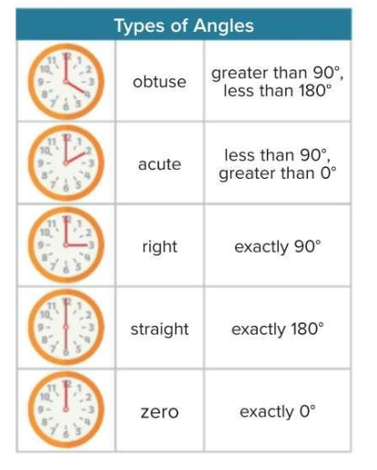

Slide 14
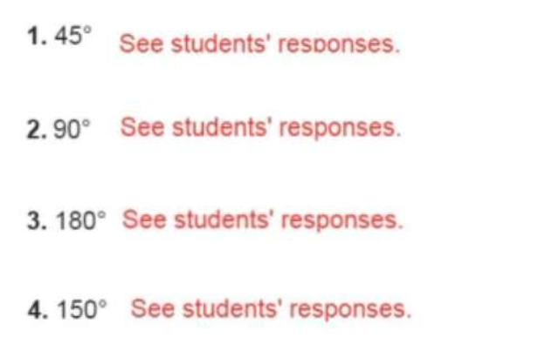
Starter…
4 min Activity
Define the type of the angle:

Slide 15
Solve the word problem.
4 min Activity
Define the type of the angle
Acute angle.
Obtuse angle.
Right angle.

Slide 16
Where do we see angles?

Slide 17
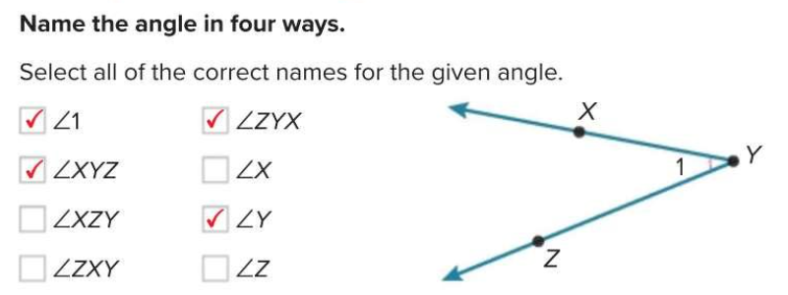
Example 1 : Teacher explanation..
Name angles
Page 678
Example1

Slide 18
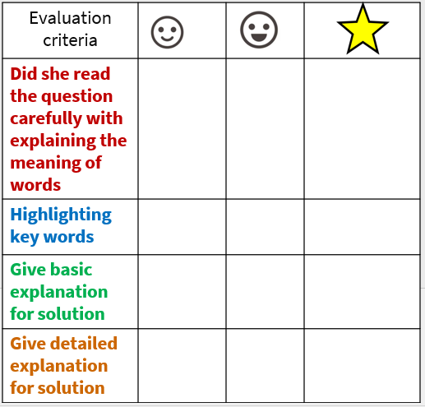
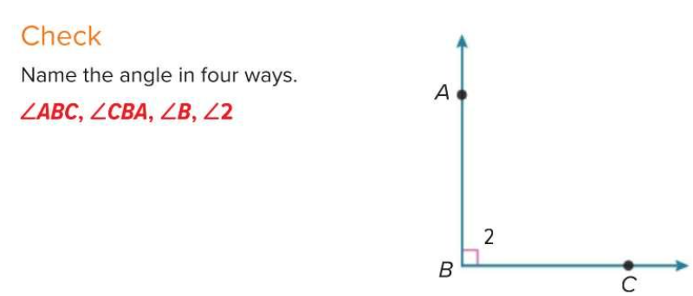
Peer assessment-Self evaluation
Solve- then check
each others work
Page 678
check

Slide 19
Vertical angles

Slide 20
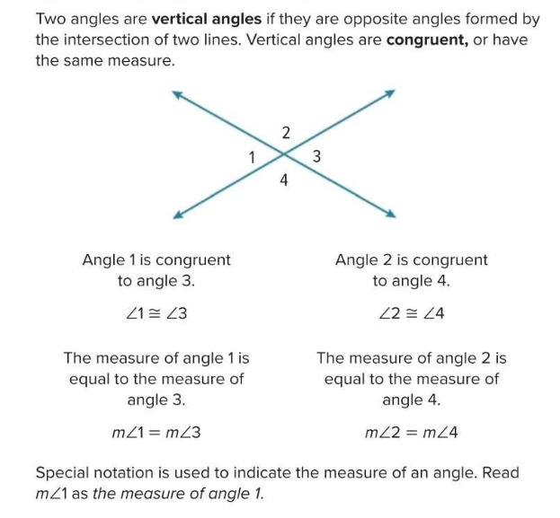
Example 2 : Teacher explanation..
Vertical angles
Page 679
Example 2

Slide 21
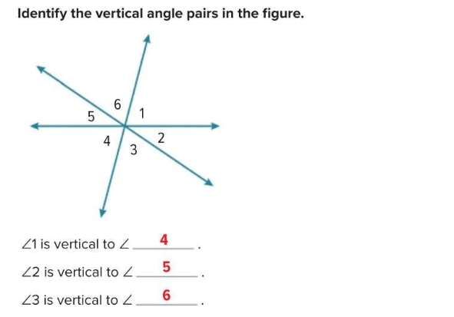
Self assessment.
Solve- then check
each others work
Page 679

Slide 22
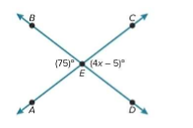
Example 3 : Teacher explanation..
Use vertical angles to find missing value
Page 680
Example 2

Slide 23
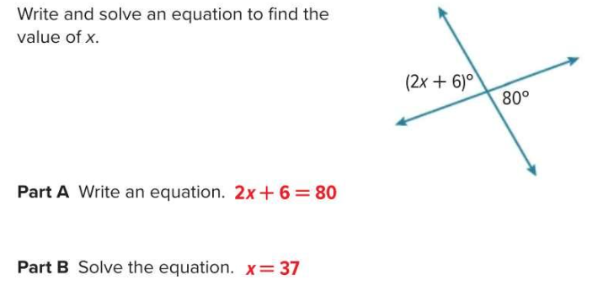
Self assessment.
Solve- then check
each others work
Page 681

Slide 24
Adjacent angles

Slide 25
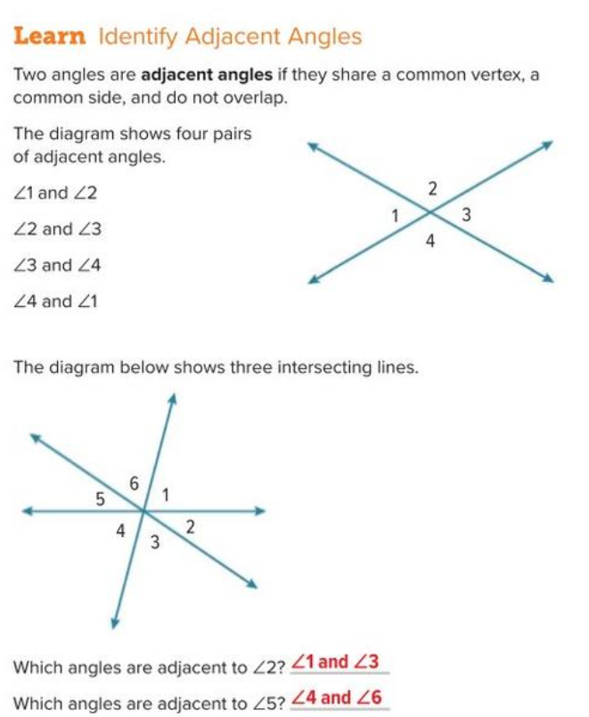
Example 2 : Teacher explanation..
Vertical angles
Page 682
Example 4

Slide 26
Peer assessment-Self evaluation
Solve- then check
each others work
Page 682
check

Slide 27
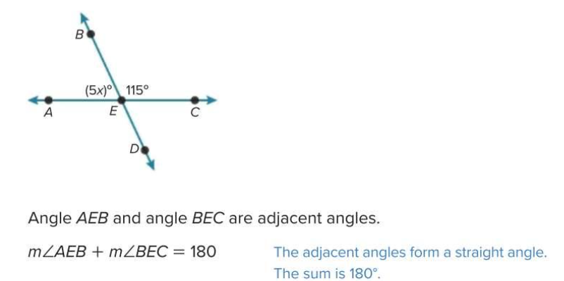
Example 5 : Teacher explanation..
Use adjacent angles to find the missing value
Page 683
Example 5
Vertical angles are equal
Rule : addition of two adjacent angles = 180

Slide 28
Self assessment.
Solve- then check
each others work
Page 684

Slide 29
7A-Student Driven differentiation.
Once finished and corrected… move to next.
Discuss the questions and explain it to each other as a group.
Note : Put the answer with explanation and details.
Al deema ahmed
Amna abdulla
Mahra Eisa
Mariam ahmed
Mariam suhail
Mouza ibrahim
Qsayed khalifa
Salama Khaled
Sara al adeeb
Sara eisa
Rauda ahmed
Alyazia hamad
Aysha sultan
Fatima khafan
Hind fahad
Latifa mohammed
Miatha ahmed
Maitha salem
Mouzoun khalifa
Sara ahmed
Wadha faisal
Wadima abdulla
Aysha abdulla
Dana Yaqoob
Alyazia abdulla
Mahra Saeed
Maitha slayem
Mouzoun ahmed
Meera khalifa
Reem ateeq
Shamma mohammed
Wadha al shebli
Question 3
Question 5
Question 7
Page 687
Page 687
Page 687

Slide 30
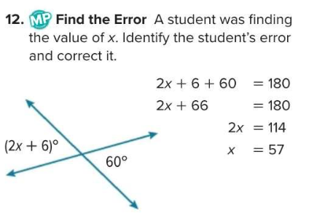
Student Driven differentiation.
Enrichment questions if you finished…
Find the error- page 688

Slide 31
Who will create our problem today?

Slide 32
Exit ticket-Student work on class-kick – 10 min
Critical thinking
Group work- Represent your work once finished.
Page 685
Apply

Slide 33
How do you think you did today?
Self evaluation

Slide 35
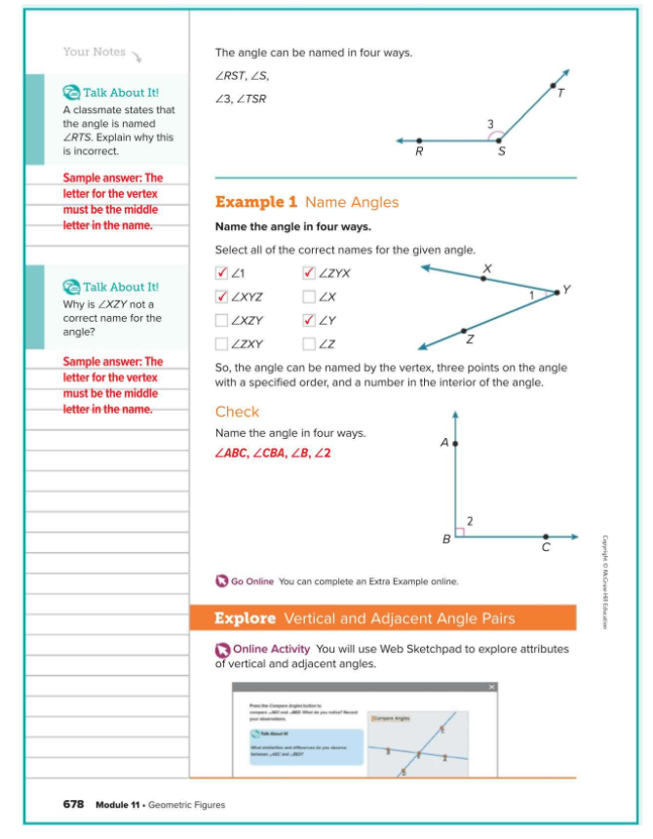
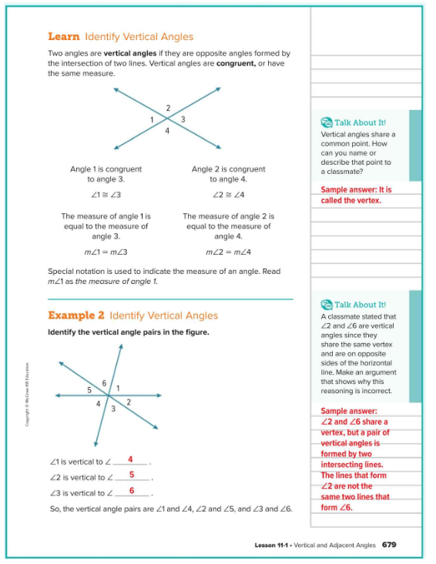
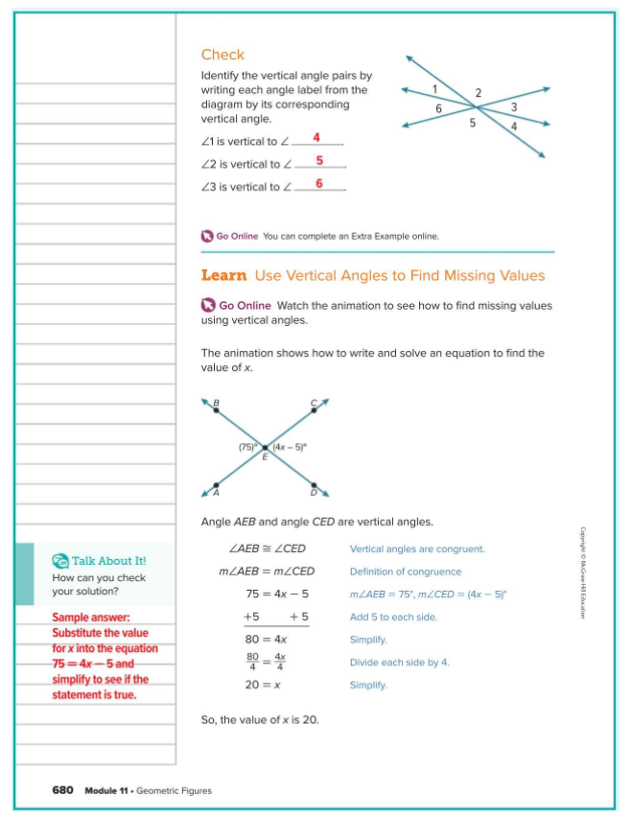

Slide 36
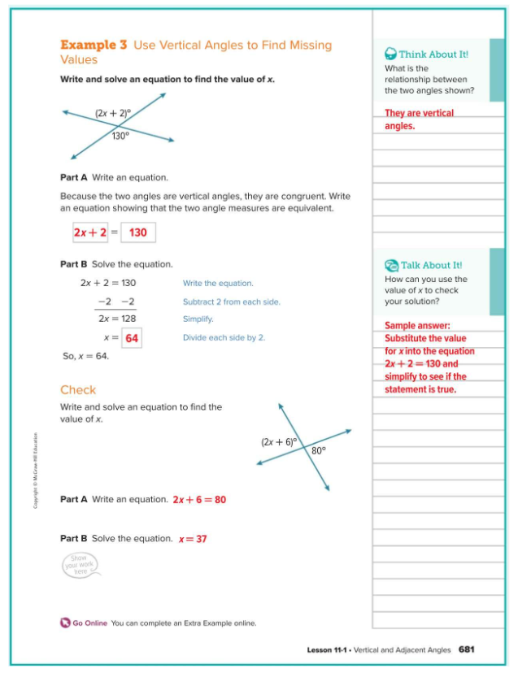
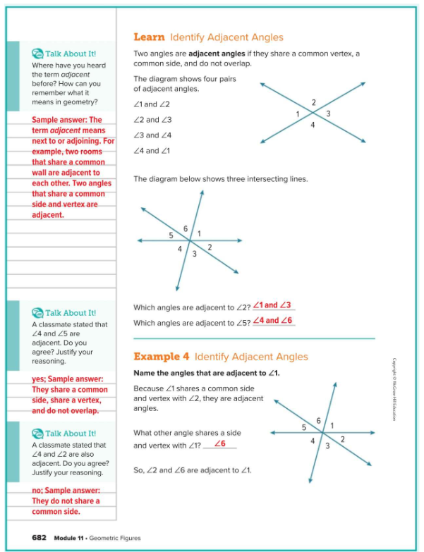
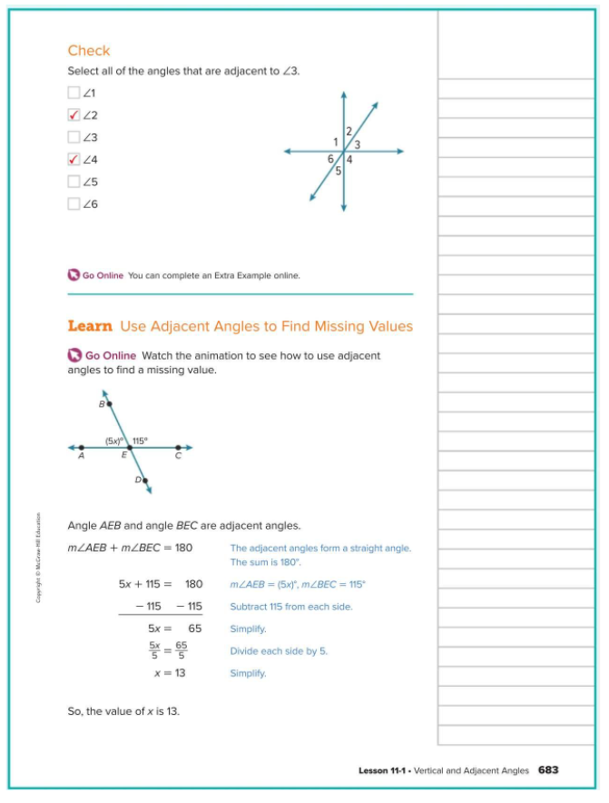

Slide 37
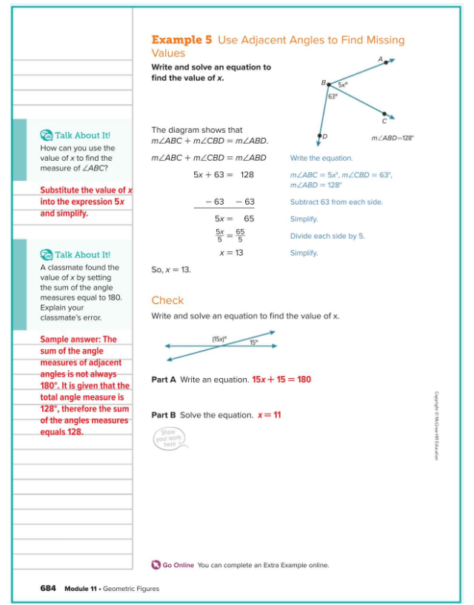
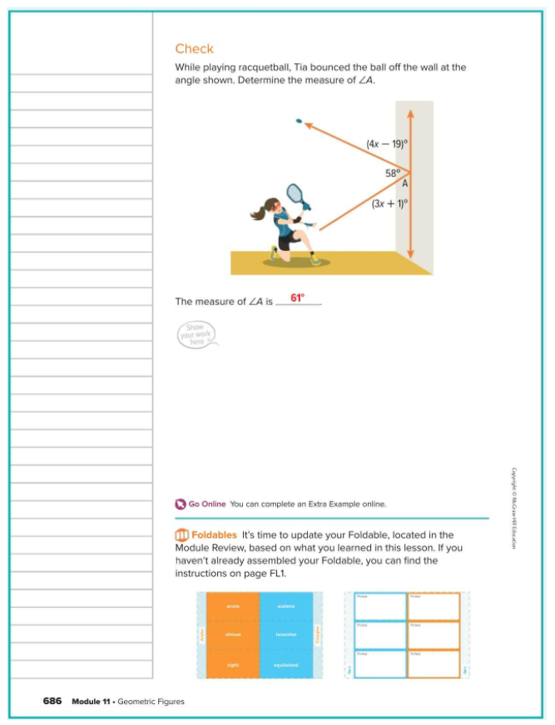

Slide 38
