Slide 1
Grade 7
Elite Mathematics
Academic Year 2021/2022 – Term 3

Slide 2
Unit 8 – Multiply decimals
P 435
Unit 11 – Geometric figures
Lesson no. 4
Lesson name:
Traingles

Slide 3
Learning objectives
Classify and draw triangles freehand, with tools, and with technology given certain conditions, such as angle measures or side lengths.

Slide 4
Keywords
Acute triangle.
Equilateral triangle.
Isosceles triangle.
Obtuse triangle.

Slide 5
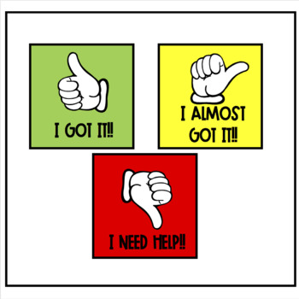

Slide 6
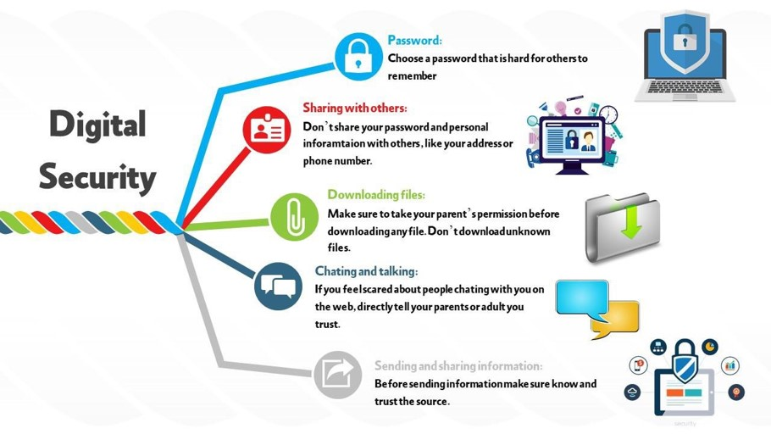

Slide 7
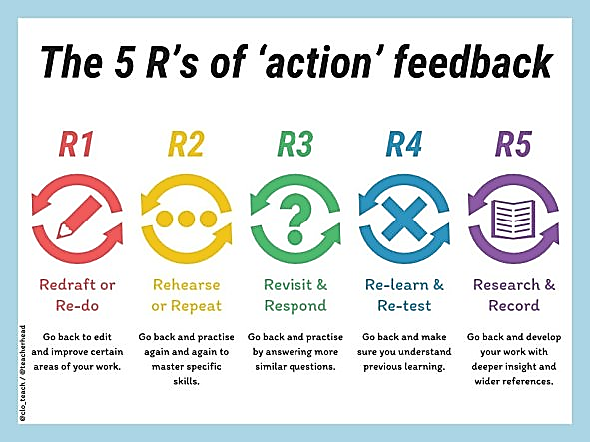
Peer assessment work- Group leaders' role.

Slide 8
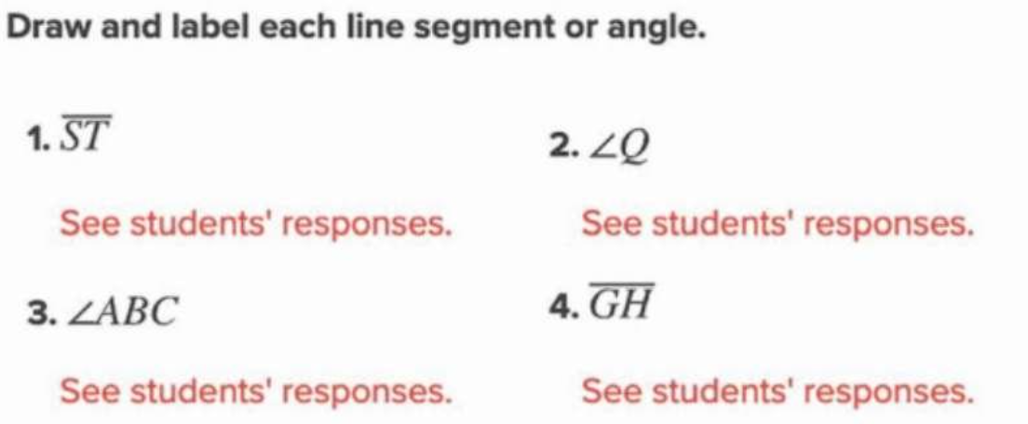
Starter…
4 min Activity

Slide 10
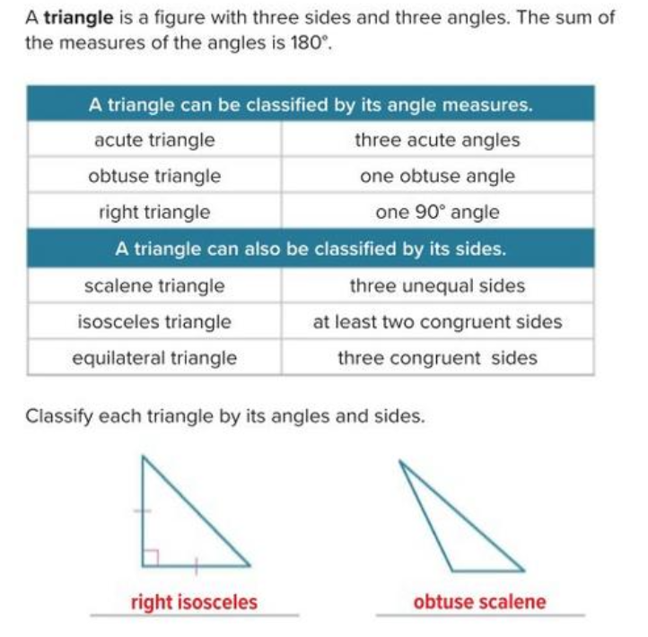

Slide 11
part 1 : Teacher explanation..
Page 713
Example 1

Slide 12
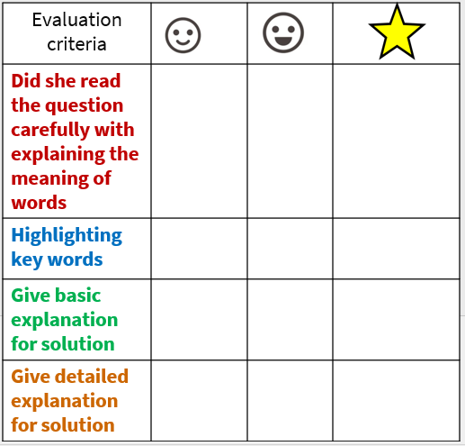
Self evaluation
Solve- then check
each others work
Page 713

Slide 13
part 2 : Teacher explanation..
Draw triangles using tools
Page 715
Explanation

Slide 14
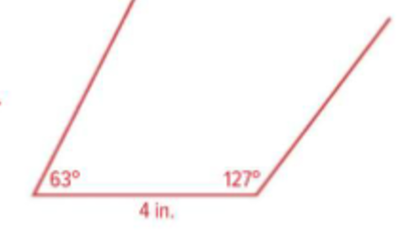
Page 716
Explanation

Slide 15
Peer assessment
Solve- then check
each others work
Page 715

Slide 16
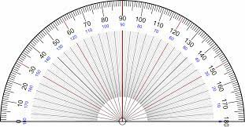

Slide 17
part 3 : Teacher explanation..
Draw triangles using tools
Page 718
Example 4
Check

Slide 18
7A-Student Driven differentiation.
Once finished and corrected… move to next.
Discuss the questions and explain it to each other as a group.
Note : Put the answer with explanation and details.
Al deema ahmed
Amna abdulla
Mahra Eisa
Mariam ahmed
Mariam suhail
Mouza ahmed
Qsayed khalifa
Salama Khaled
Sara al adeeb
Sara eisa
Rauda ahmed
Alyazia hamad
Aysha sultan
Fatima khafan
Hind fahad
Latifa mohammed
Miatha ahmed
Maitha salem
Mouzoun khalifa
Sara ahmed
Wadha faisal
Wadima abdulla
Aysha abdulla
Dana Yaqoob
Alyazia abdulla
Mahra Saeed
Maitha slayem
Mouzoun ahmed
Meera khalifa
Reem ateeq
Shamma mohammed
Wadha al shebli
Question 1
Question 5
Question 7
Page 719
Page 719
Page 719

Slide 19
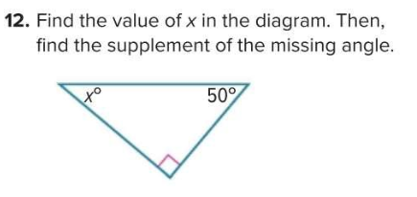
Student Driven differentiation.
Enrichment questions if you finished…
Justify-page 720

Slide 20
Exit ticket-Student work on class-kick – 10 min
Critical thinking
Group work- Represent your work once finished.
Page 696
Apply

Slide 21
How do you think you did today?
Self evaluation

Slide 23
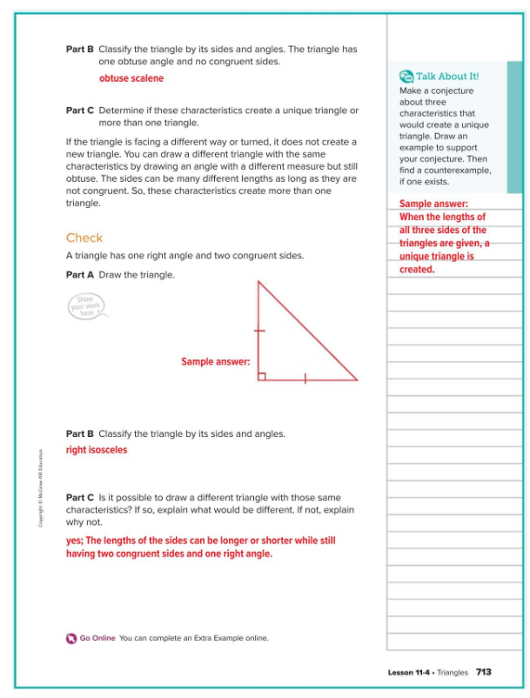
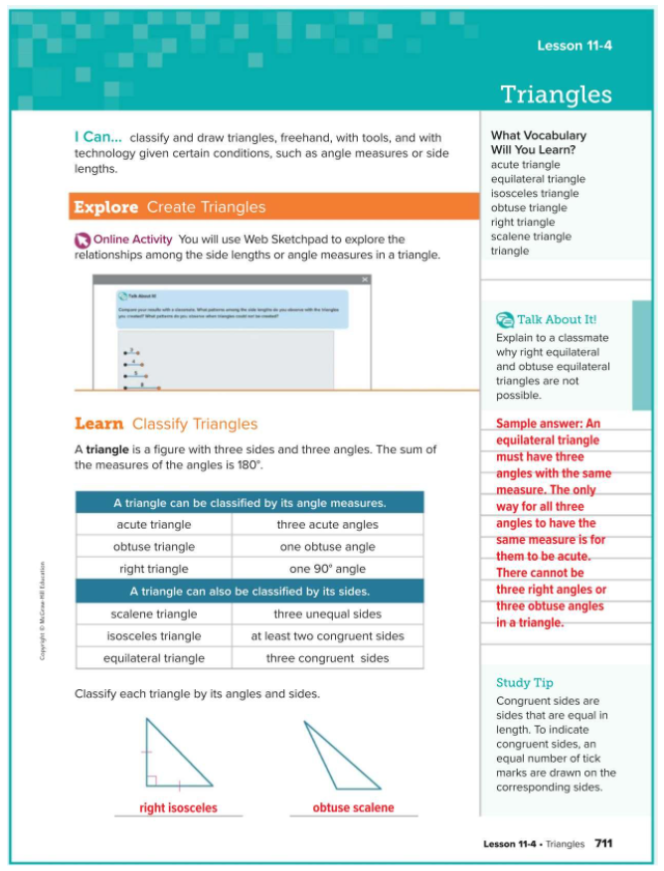
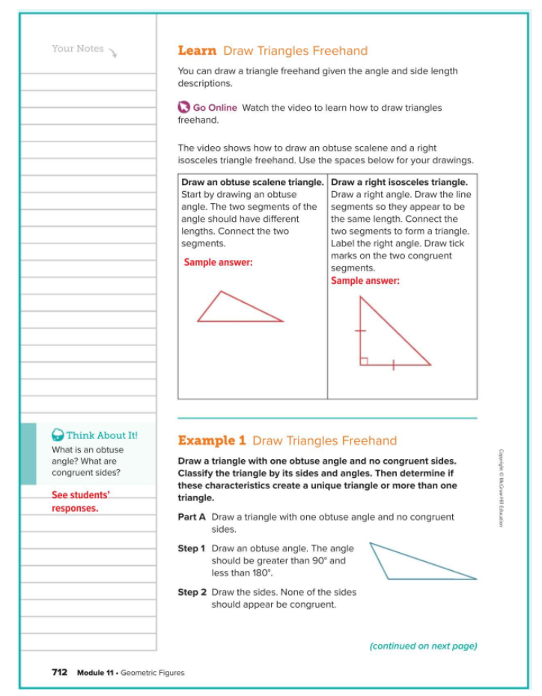

Slide 24
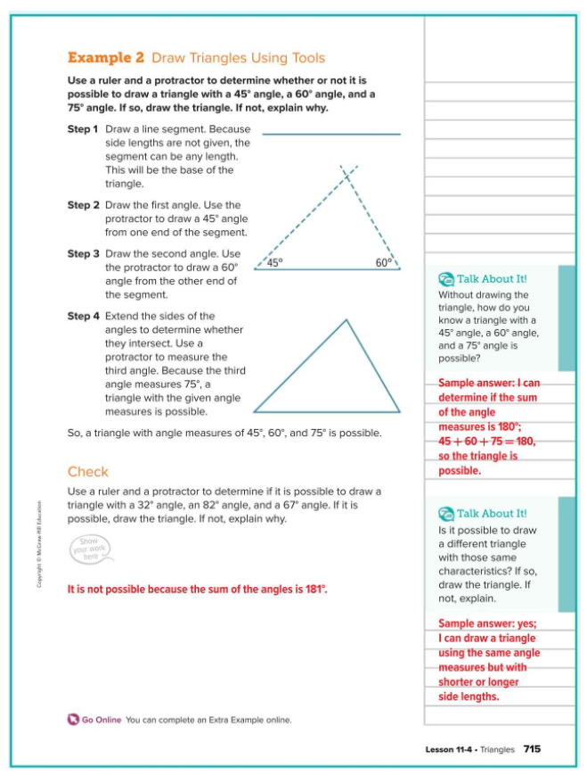
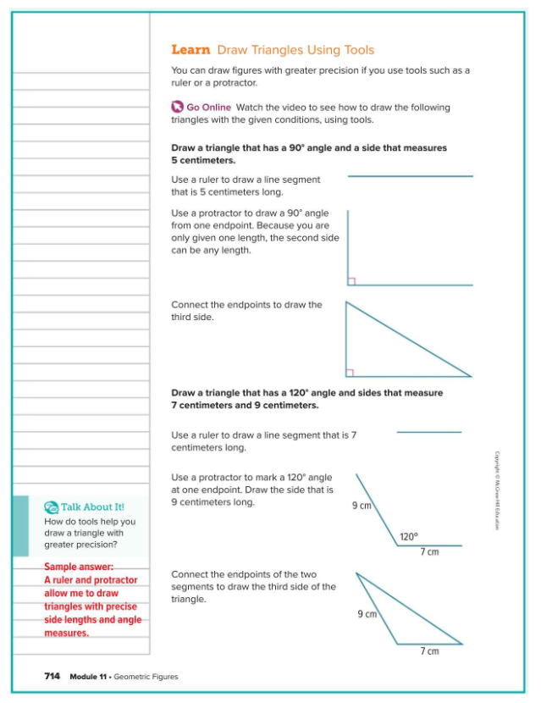
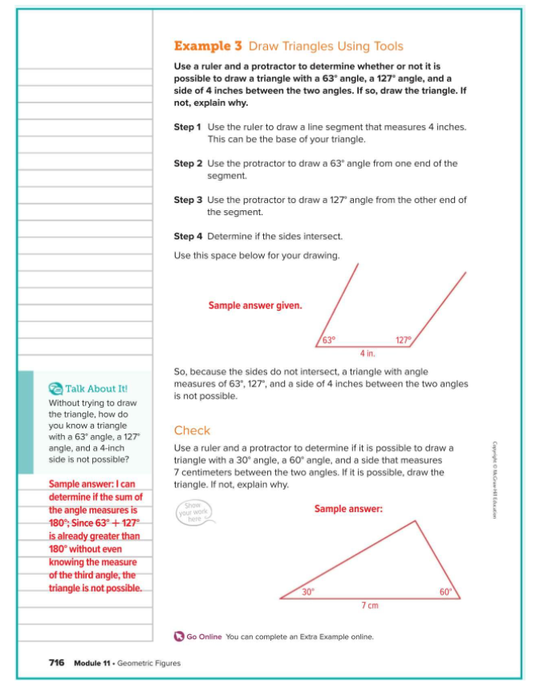

Slide 25
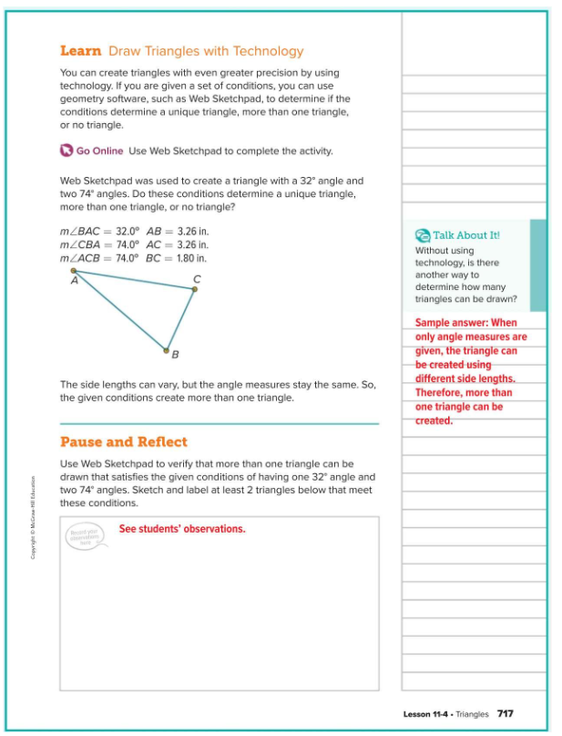
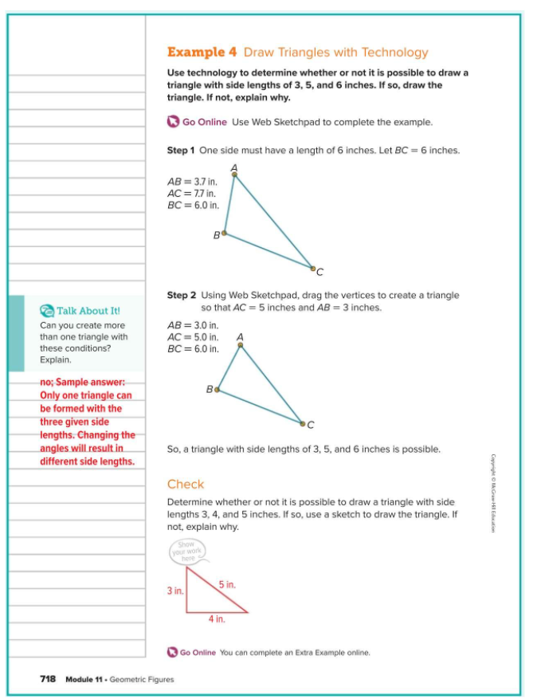
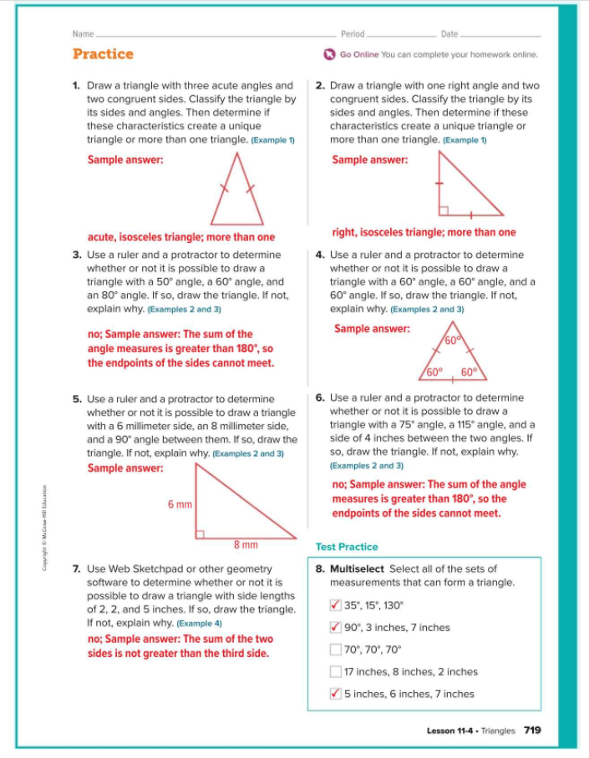

Slide 26
