Slide 1
Grade 7
Elite Mathematics
Academic Year 2021/2022 – Term 3

Slide 2
Unit 8 – Multiply decimals
P 435
Unit 11 – Geometric figures
Lesson no. 3
Lesson name:
Angle relationships and parallel lines

Slide 3
Learning objectives
Use the relationships between angles to find the measures of missing angles.

Slide 4
Keywords

Slide 5
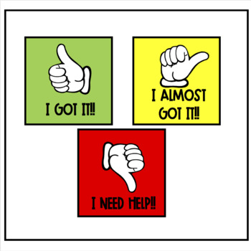

Slide 7
Peer assessment work- Group leaders' role.

Slide 8
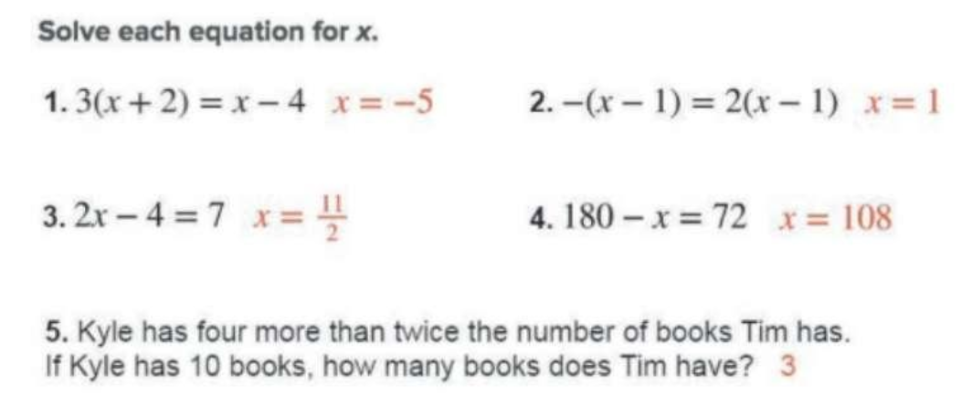
Starter…
4 min Activity

Slide 10
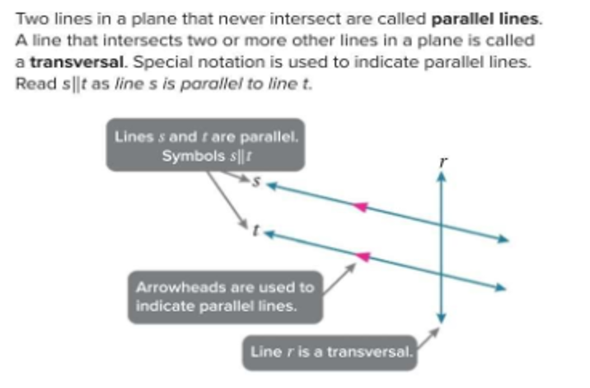
part 1 : Teacher explanation..
Page 699-700
Explanation

Slide 11
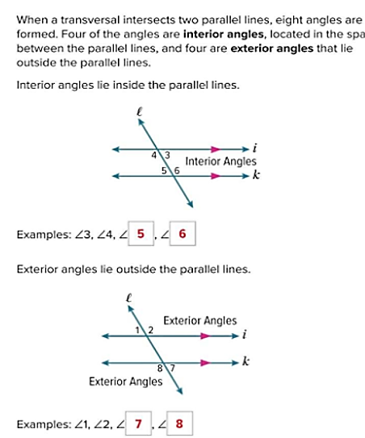
part 2 : Teacher explanation..
Interior and exterior angles
Page 700
Explanation

Slide 14
7A-Student Driven differentiation.
Once finished and corrected… move to next.
Discuss the questions and explain it to each other as a group.
Note : Put the answer with explanation and details.
Al deema ahmed
Amna abdulla
Mahra Eisa
Mariam ahmed
Mariam suhail
Mouza ahmed
Qsayed khalifa
Salama Khaled
Sara al adeeb
Sara eisa
Rauda ahmed
Alyazia hamad
Aysha sultan
Fatima khafan
Hind fahad
Latifa mohammed
Miatha ahmed
Maitha salem
Mouzoun khalifa
Sara ahmed
Wadha faisal
Wadima abdulla
Aysha abdulla
Dana Yaqoob
Alyazia abdulla
Mahra Saeed
Maitha slayem
Mouzoun ahmed
Meera khalifa
Reem ateeq
Shamma mohammed
Wadha al shebli
Question 1&4
Question 7
Question 10
Page 697
Page 697
Page 697

Slide 15
Student Driven differentiation.
Enrichment questions if you finished…
Justify-page 698

Slide 16
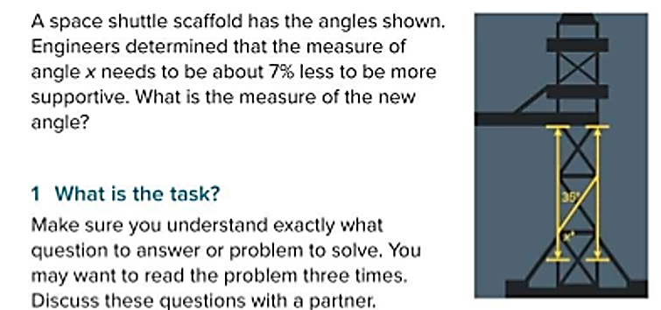
Exit ticket-Student work on class-kick – 10 min
Critical thinking
Group work- Represent your work once finished.
Page 696
Apply

Slide 17
How do you think you did today?
Self evaluation

Slide 19
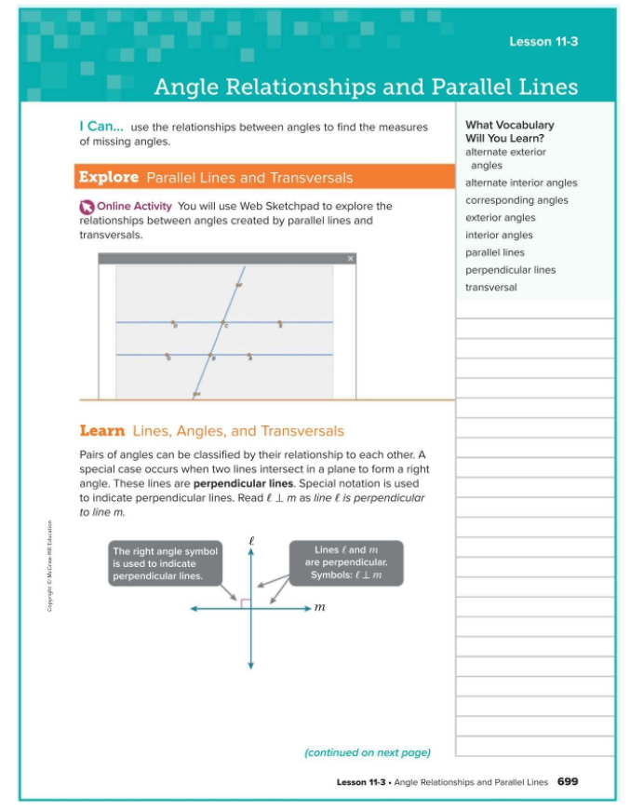
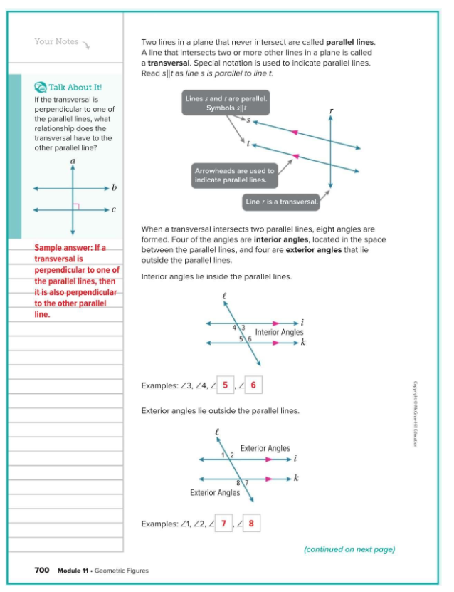
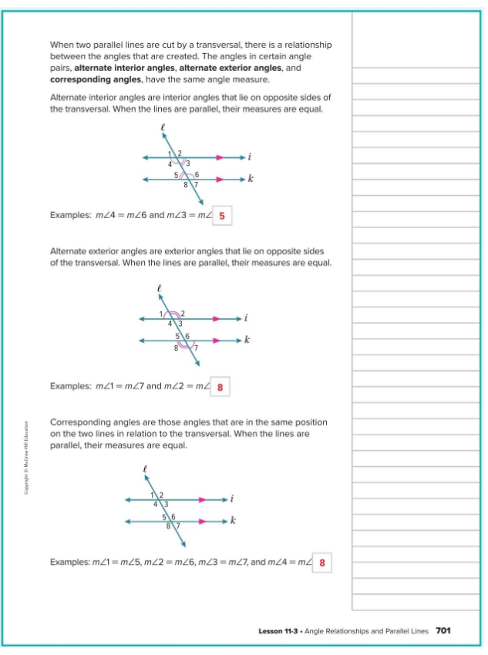

Slide 23
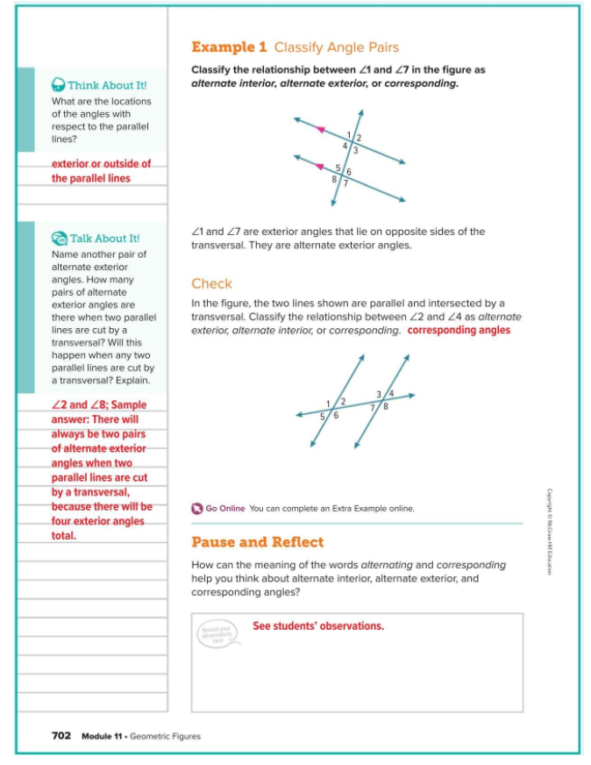
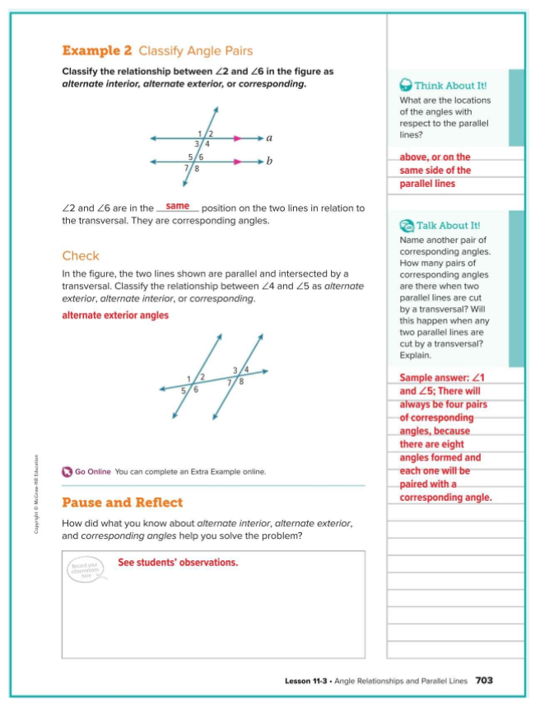
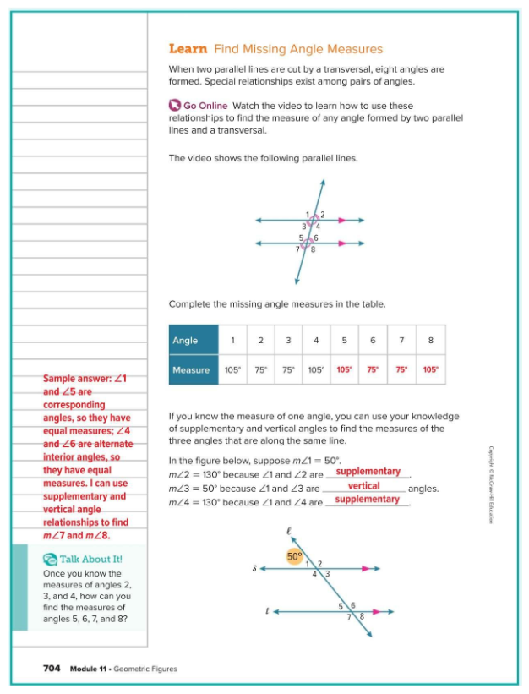
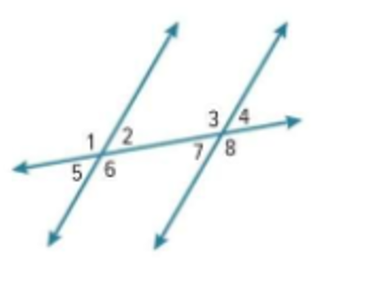

Slide 24
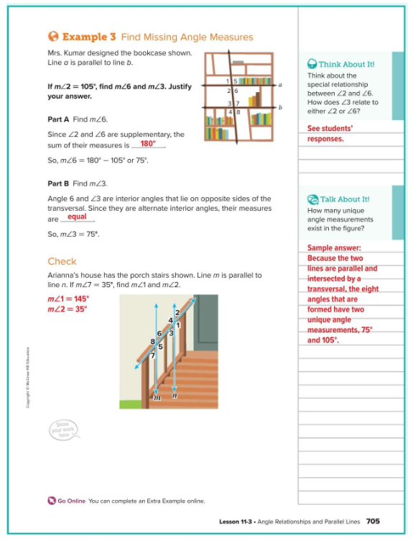
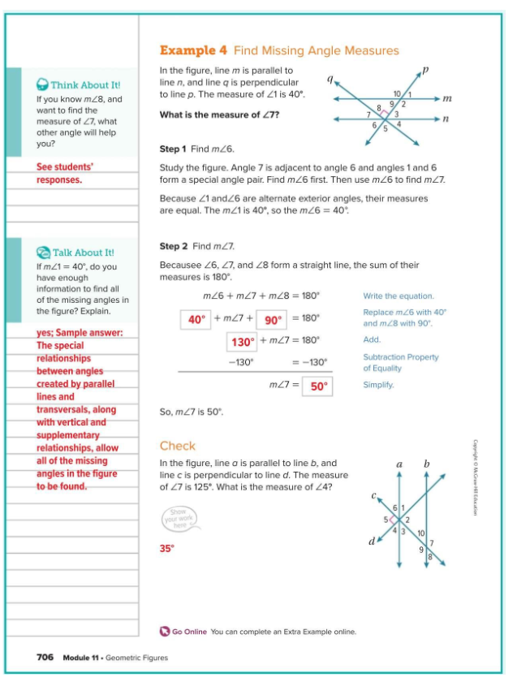
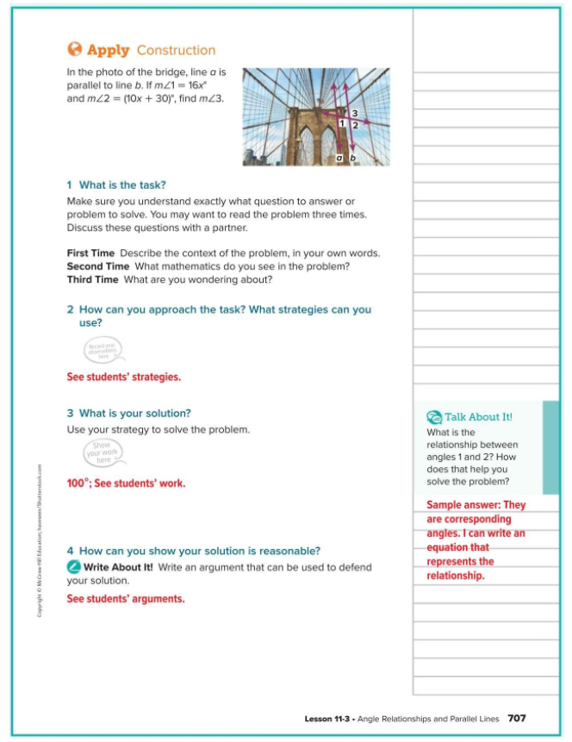
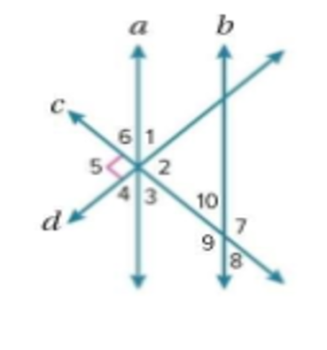

Slide 25
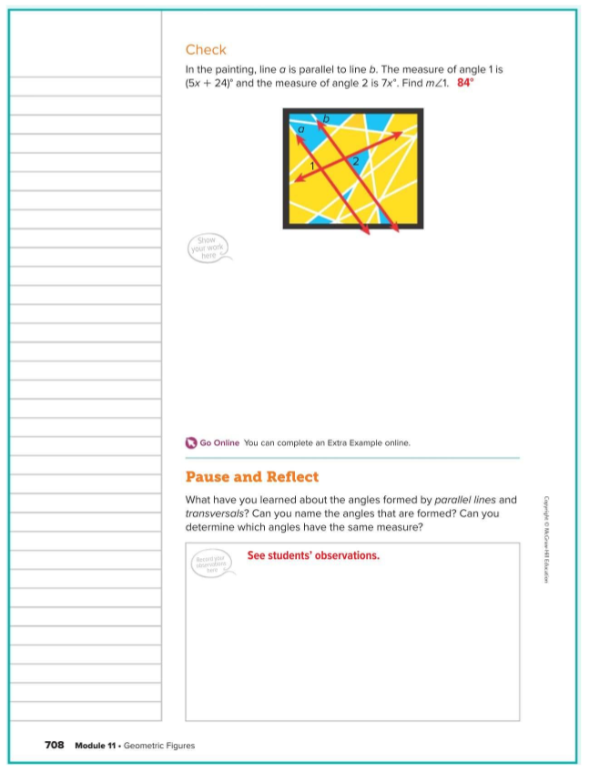
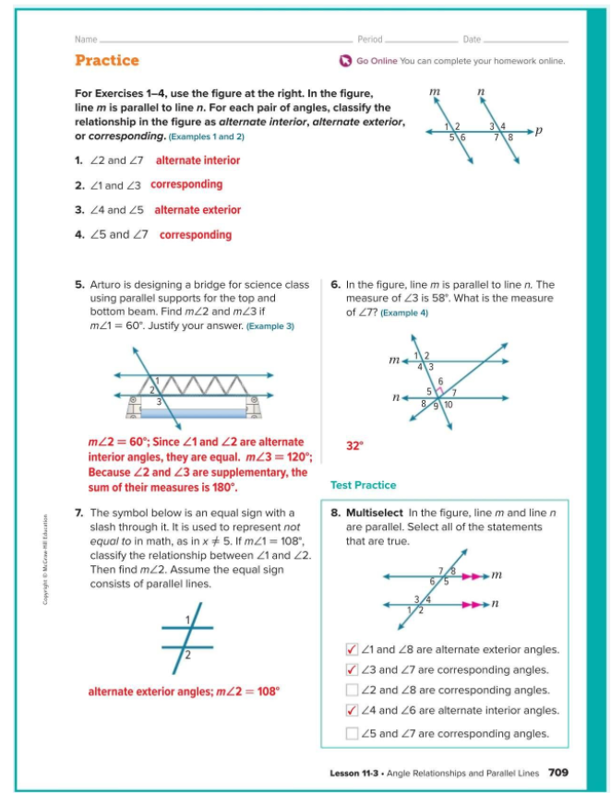
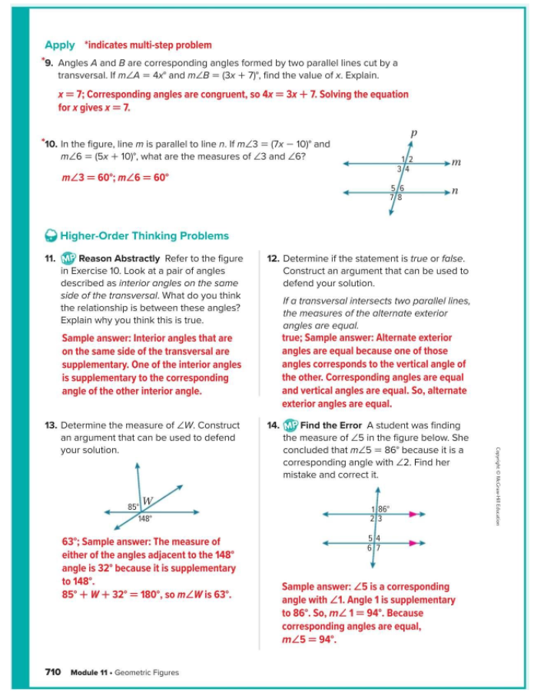

Slide 26
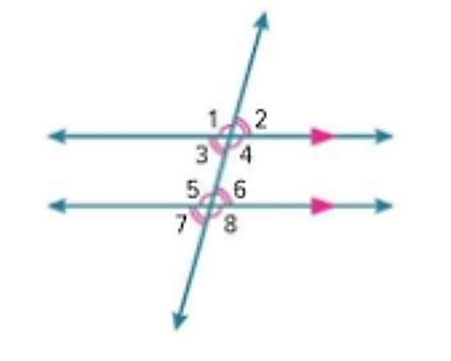

Slide 27
