Slide 1
M11L5 – Angle Relationships and
Triangles
27-04-2023
Federal Entity | هيئة اتحادية

Slide 2
Learning Objective
• Find the measures of interior and exterior
angles in a triangle by using relationships
between these angles.

Slide 3
Triangles
(Page 721)

Slide 4
Main Headline
Body Copy

Slide 6
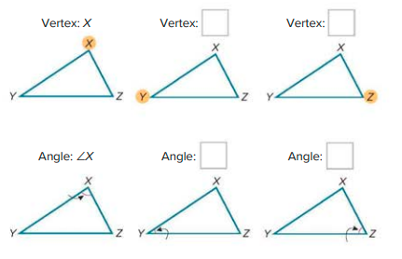

Slide 7
Angle Sum of Triangles
(Page 723)

Slide 8
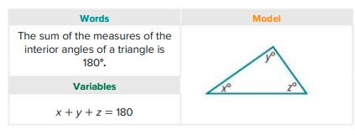
Main Headline
Body Copy

Slide 9
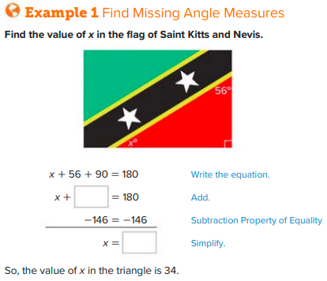

Slide 11
Use Ratios to Find Angles Measures
(Page 724)

Slide 12
Body Copy

Slide 13
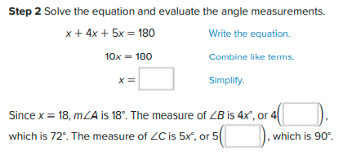

Slide 15
Exterior Angles of Triangles
(Page 725)

Slide 16
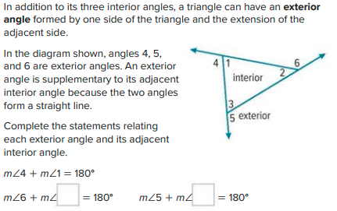
Main Headline
Body Copy

Slide 17
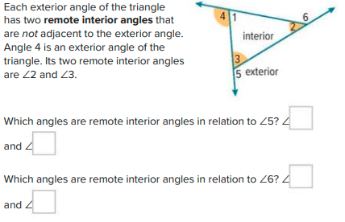

Slide 18
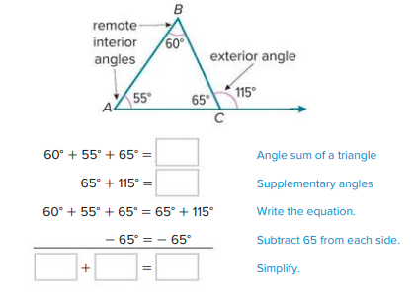

Slide 20
Find Exterior Angle Measures
(Page 727 + 728)

Slide 21
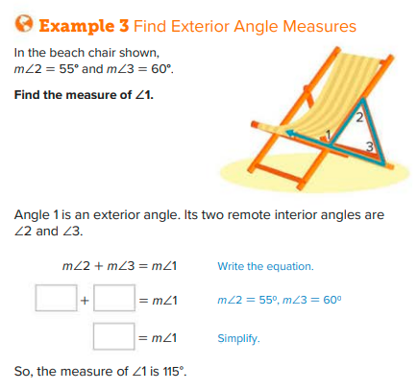
Main Headline
Body Copy

Slide 22
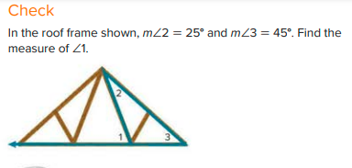

Slide 24
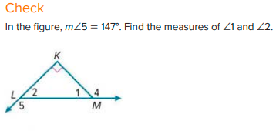

Slide 25
Check
(Page 730)

Slide 26
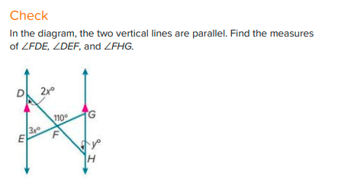
Main Headline
Body Copy

Slide 27
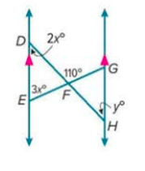

Slide 28
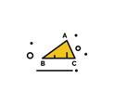

Slide 29
Follow us
ese.ae
Ese_ae

