Slide 1
U2M1L2 FORCE AND ACCELERATAION

Slide 2
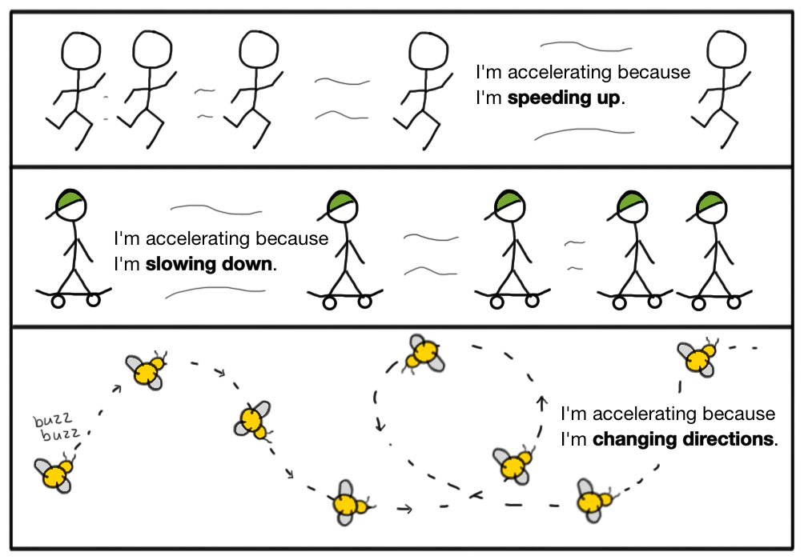
What can cause a change of motion?
Recall that velocity changes if either speed or direction changes.
When a car moves faster, its velocity increases. When a car slows down, its velocity decreases. If the car turns, its velocity changes because its direction changes.

Slide 4
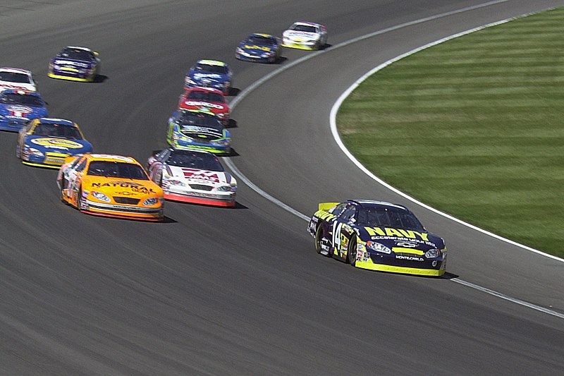
What can cause a change of motion?
When the car’s velocity changes, the car is accelerating.
Acceleration Is a measure of the change in velocity during a period of time.
An object accelerates when its velocity changes as a result of increasing speed, decreasing speed, or a change in direction.
Like velocity, acceleration has a direction.
Acceleration can be represented by an arrow. The length of the arrow shows the amount of acceleration.

Slide 5
The direction of an acceleration arrow depends on whether velocity is increasing or decreasing

Slide 6
Forces
A push or a pull on an object is called a force.
Some forces are applied only when objects touch. Other forces are applied even when objects do not touch.
A contact force is a push or a pull on one object by another that is touching it. Contact forces can be weak. When you press the keys on a computer keyboard, the contact force is weak.
They can also be strong. The plates, or rock slabs, that make up Earth’s crust can apply strong contact forces against each other. Over long periods of time, these forces can be strong enough to form mountain ranges if one plate pushes another plate upward

Slide 7
https://www.liveworksheets.com/worksheets/en/Science/Forces/Types_of_forces_qj1671049zl

Slide 9
Mathematical Model
Newton’s second law of motion describes the relationship between an object’s acceleration and the net force that acts on the object.
According to Newton’s second law of motion, the acceleration of an object is equal to the net force acting on the object divided by the object’s mass.
The direction of acceleration is the same as the direction of the net force.

Slide 15
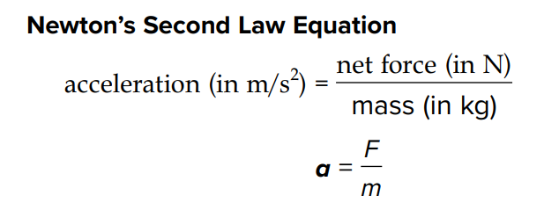

Slide 16
https://www.liveworksheets.com/qe1328225zu

Slide 17
How does friction affect motion?
Why does a baseball player slow down as he slides into a base?

Slide 18
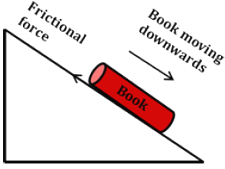
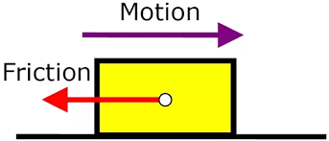
FRICTION FORCE
Friction is a contact force that resists the sliding motion between two objects that are touching.
The force of friction acts in the opposite direction of the motion.

Slide 19
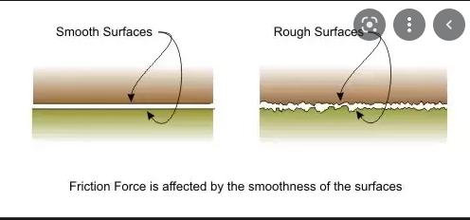
FRICTION FORCE
Friction is a force that resists the sliding motion of two surfaces that are touching.
As he slides to the base, the player must overcome friction from the ground, which is exerting a force away from the base.
Rougher surfaces produce greater friction than smooth surfaces. Other factors, such as the surface area and the weight of an object, also affect the force of friction.
https://phet.colorado.edu/sims/html/forces-and-motion-basics/latest/forces-and-motion-basics_en.html

Slide 21
Friction and Newton’s Laws
Imagine a book sitting on a table. When you push the book, the book moves. This is because the force you apply to the book is greater than the friction between the book and the table. The book moves in the direction of the greater force. If you stop pushing, friction stops the book, just like the friction between tires and the road stops a car.
What would happen if there were no friction between the book and the table?
According to Newton’s second law, the book would continue to move at the same speed in the same direction unless a force changed its motion. The book stopping is evidence that friction is acting on the book.

Slide 22
How do multiple forces change motion?
Force has both size and direction. Arrows can be used to show the size and direction of a force. Usually more than one force is acting on an object at a time.
The forces can be added together to find the net force.
The net force is the sum of all the forces acting on an object.
The net force can be modeled with a free-body diagram.
A free-body diagram is a simple model that can help you understand the forces acting on an object.

Slide 23
How can forces act on an object that is not changing its motion?
Newton’s First Law
Sir Isaac Newton studied how forces affect the motion of objects. He developed three rules that are known as Newton’s laws of motion.
Newton’s first law of motion states that if the net force on an object is zero, the motion of the object does not change.
As a result, balanced forces and unbalanced forces have different results when they act on an object.

Slide 24
Newton’s first law of motion states that if the net force on an object is zero, the motion of the object does not change.

Slide 25
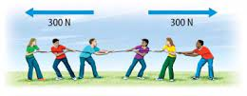
Balanced and Unbalanced Forces
According to Newton’s first law of motion, balanced forces cause no change in the motion of an object. This is true when an object is at rest or in motion. A dresser is at rest before anyone pushes on it. It remains at rest when balanced forces are applied

Slide 26
https://www.liveworksheets.com/lr1435916ss

Slide 27
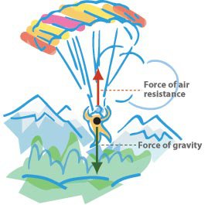
Both gravity and air resistance act on the motion of a parachutist. Gravity pulls the parachutist toward the ground. Air resistance against the parachute slows the fall.

Slide 28
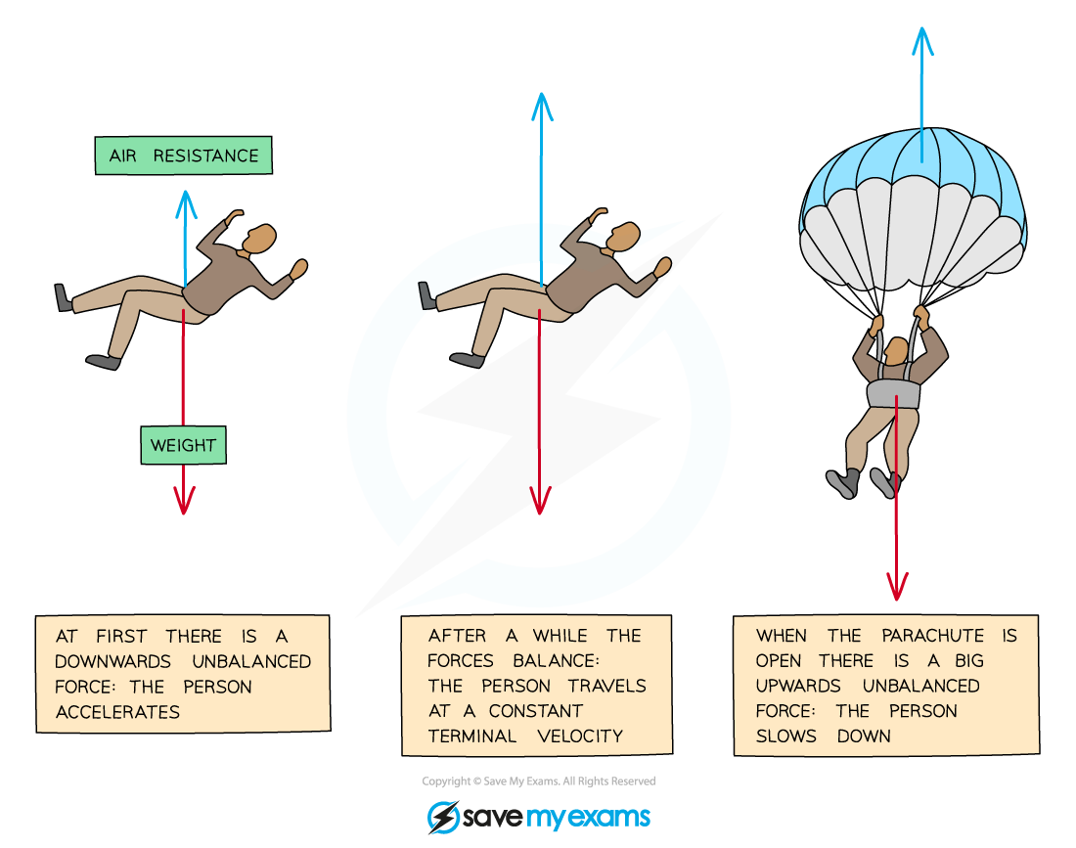
When the air resistance and gravity on the parachutist are balanced, the parachutist moves downward with a constant velocity known as terminal velocity.
Recall that velocity is the speed and the direction of motion.
Terminal velocity is the constant velocity reached when air resistance equals the force of gravity on a falling object.

